Slide 1
Locate Support
Locate Admin Panel Redesign

Slide 2
Requirements
Move from Classic ASP to .Net
Create token structure similar to VL Plus
The Tokens will be as follows:
VIN Search – gives user access to the VIN Search page for New and Used
Trade Manager – gives user access to look up trades and pull trade history reports
Dealer Search – gives user access to search for dealers, includes dealer info and high level inventory information
Reports – gives user access to certain reports
File Process – gives user access file process data for monitoring purposes
Admin – gives user access to the admin screen for removing and adding users
Setting – gives user access to User Profile setting screen
Naming convention for token should ‘LS_PageName’ i.e. ‘LS_VINSearch’
Add admin screen for internal users (Locate Team) only to add/remove users

Slide 3
Pages
VIN Search
New
Search by VIN
Image count search
Used
Search by VIN
Trade Manager
Dealer Search
Reports
File Process
Admin
Settings

Slide 4
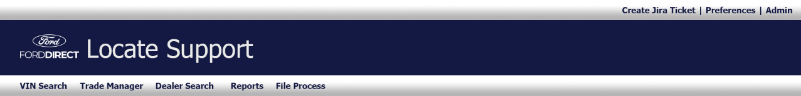
Header
Sub navigation bar
Create Jira Ticket Links out to Jira – Service Request Issue type – this will be an external link only for Jira access.
Preferences – this will link to the User Profile preference page.
Admin – this will link to the Admin Screen
Main navigation bar
VIN Search
Trade Manager
Dealer Search
Reports
File Process

Slide 5
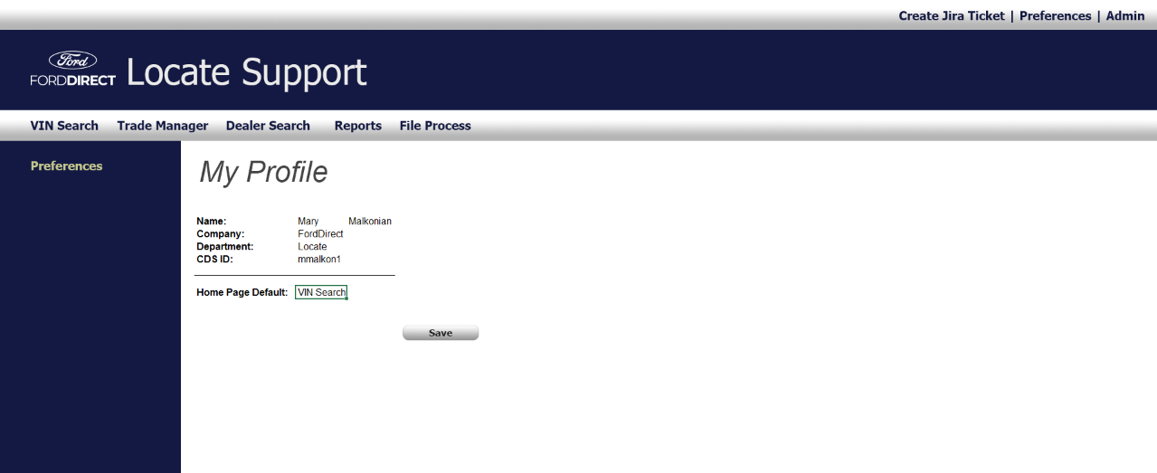
Preferences
Allow user to change the home default page, the rest of the information will be automatically populated from the DB.
Dropdown menu to choose from:
VIN Search, Trade Manager, Dealer Search, Reports and File Process.

Slide 6
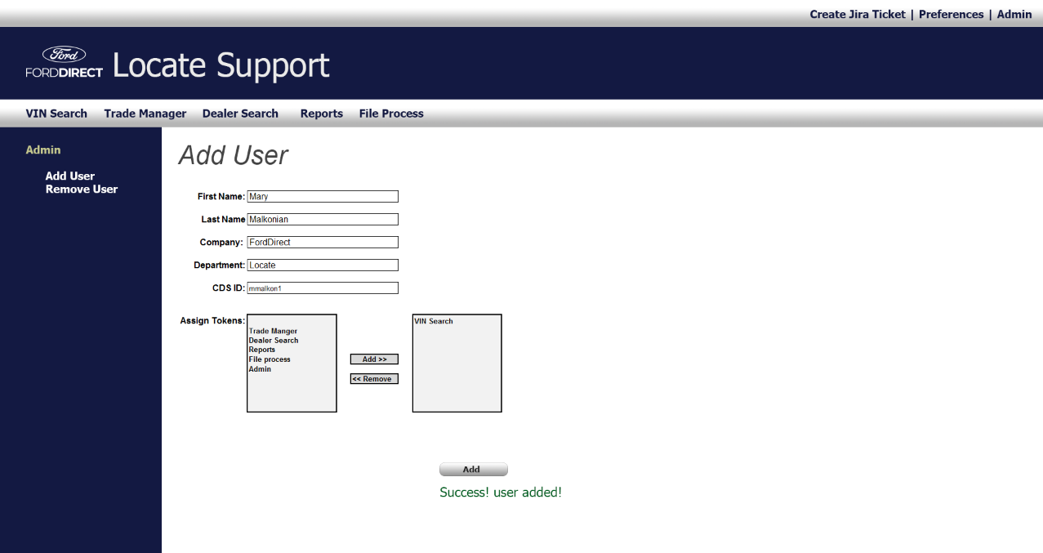
Admin > Add User
Allows user to add a user and assign tokens.

Slide 7
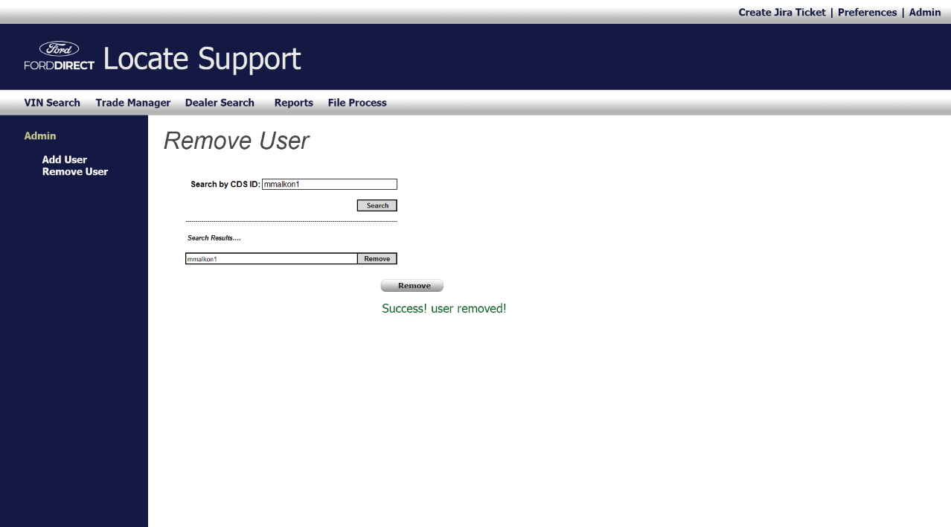
Admin > Remove User
Allows user to remove.

Slide 8
Admin > Remove User
Allows user to add a user and assign tokens.

